Slide 1
Artifical Intelligence based Chess Commentator
Som Sridhar Roy

Slide 2

AI Chess Commentator
This web application allows users to play chess against the computer. It includes an AI commentator feature that explains the moves made during the game.
Offers immediate insights into strategic decisions and potential pitfalls during gameplay.
Helps players of all levels improve their skills by explaining both basic and advanced moves.

Slide 3
AGENDA
Introduction to the AI Chess Commentator: Overview and purpose of the project.
Features and Functionality: Highlighting real-time analysis, personalized feedback, and interactive learning.
Educational Value: Discussing its role as an educational tool for players of all levels.
Technical Implementation: Insights into the technical stack and integration with Google Generative AI.
Future Development and Community Engagement: Plans for enhancing commentary capabilities and fostering community feedback.

Slide 4

Problem Statement
Chess players lack real-time feedback and personalized insights during gameplay, hindering their skill development.
There's a need for a solution providing comprehensive, real-time commentary tailored to players' needs and language preferences, enhancing the chess-playing experience and fostering skill development.

Slide 5

Project Overview
Our project aims to revolutionize the chess-playing experience by introducing an AI Chess Commentator.
By leveraging advanced algorithms and machine learning techniques, our AI commentator enhances the educational value of chess, helping players of all skill levels improve their strategic thinking and decision-making abilities.

Slide 6

END USERS
Chess Enthusiasts:
Individuals passionate about chess, ranging from beginners to experienced players, seeking to improve their skills and enjoy the game.
Students and Learners:
Chess students and learners, including those enrolled in chess clubs, schools, or online courses, looking for educational resources and interactive learning experiences.

Slide 7
SOLUTION
Our solution, the AI Chess Commentator, revolutionizes the chess-playing experience by providing real-time commentary and analysis during gameplay.
Value Proposition:
Our AI Chess Commentator provides real-time, personalized commentary, enhancing the educational value of chess and breaking down language barriers for a global audience of players.

Slide 8

WOW FACTOR
By combining advanced AI technology with real-time commentary and personalized insights, our solution offers a dynamic and engaging platform that not only enhances players' skills but also fosters a sense of community and collaboration among chess enthusiasts worldwide.
It's not just about playing chess; it's about learning, growing, and experiencing the game in a whole new way.

Slide 9
MODELING
Game Representation:
Utilize a suitable data structure to represent the chess game, including the board state and piece positions.
Commentary Generation:
Design algorithms using natural language processing techniques to generate commentary and explanations for the moves made during the game.
User Interaction:
Incorporate user interaction features, allowing players to interact with the AI commentator, ask questions, and request further explanations.

Slide 10
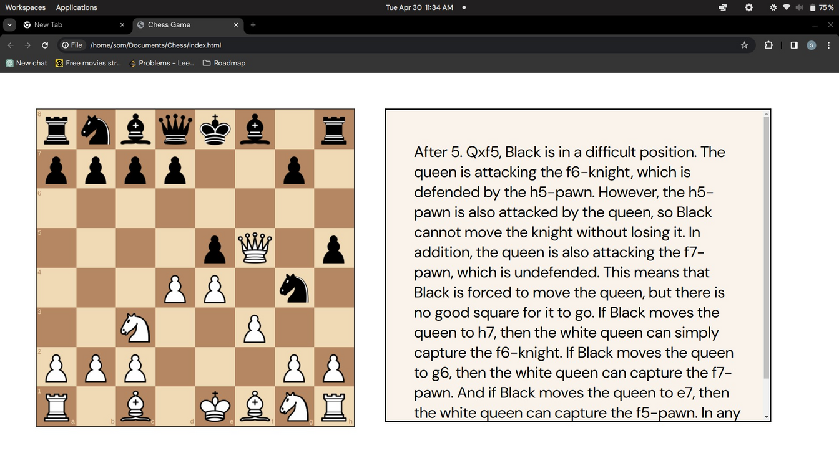
RESULTS
The project successfully integrated the generative AI model with the Gemini Pro API, enabling seamless access to chess position analysis functionalities within the platform, and implemented interactive visualization components using chessboard.js to display analyzed positions and recommended moves to users. Evaluation involved assessing the generative AI model's performance in providing accurate analyses and gathering user feedback through testing to evaluate usability and effectiveness. Optimization efforts focused on enhancing efficiency and scalability, leading to the deployment of the integrated solution on the Gemini Pro platform with ensured compatibility. Monitoring mechanisms were implemented to track system performance and user interactions, while regular updates to the AI model and system components were made to incorporate new features and address evolving user needs
and preferences.

